Slide 1

WATER INTAKE FOR EFFICIENT Hydration
Stay hydrated, sip water throughout day

Slide 2


Team Mates
TANVIK SRI RAM REDDY (URK23CS1261)
NIVESH R (URK23CS1262)
BIJJAM DINESH REDDY (URK23CS1263)

Slide 3

ABSTRACT
User-friendly app for managing water intake.
Clean interface for easy registration and tracking.
Dynamic dashboard shows hydration status and progress.
Customize settings for personalized experience.
Responsive design for smooth navigation on any device.
Promotes healthy hydration habits for well-being.

Slide 4

PROBLEM STATEMENT
Many struggle with hydration, causing health problems.
Current solutions lack user-friendly interfaces.
Users need intuitive apps to track intake.
Existing options lack customization and error logging.
Critical need for user-centric hydration apps.
Seamless tracking, customization, and error logging required.

Slide 5

METHODOLOGY
Project organization: Divided into manageable modules.
Classes and objects: Blueprints for different program sections.
Database utilization: Data storage and retrieval for user access.
User interface design: Easy-to-understand layout and appearance.
Action response: Program reacts to user interactions.
Error handling: Smooth operation with efficient debugging.

Slide 6

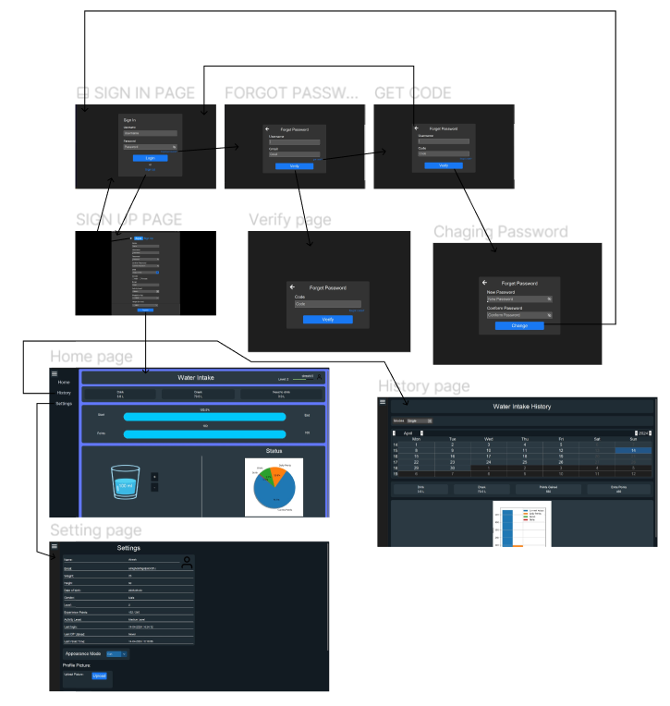
ARCHITECTURE
Our app is simple, easy: modular, intuitive, responsive, error-proof

Slide 7
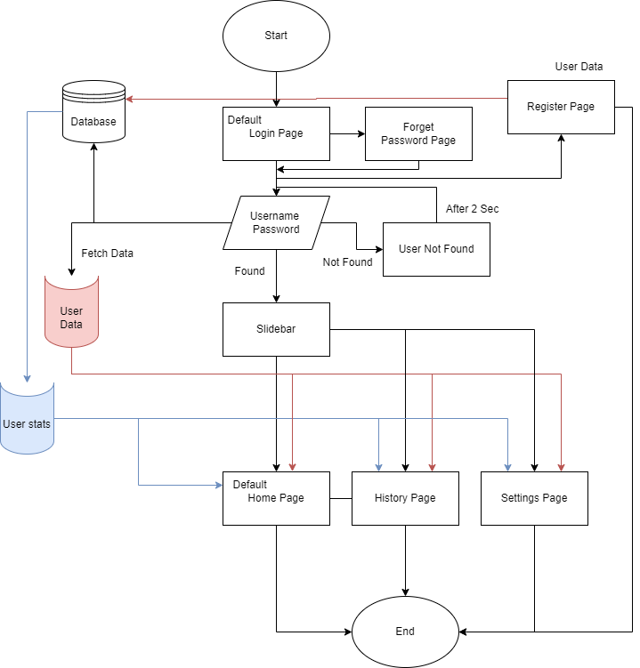
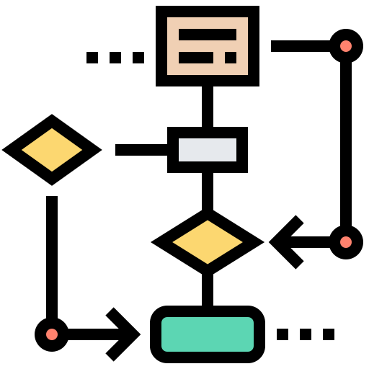
Flow Chart

Slide 8
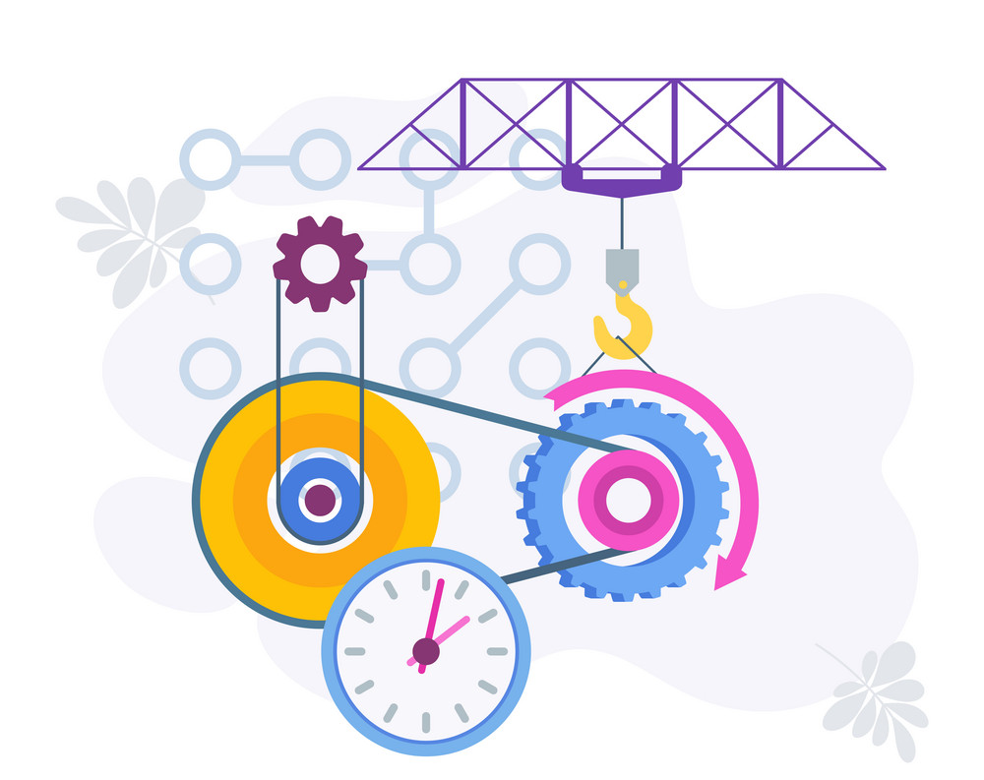
IMPLEMENTATION

Slide 9
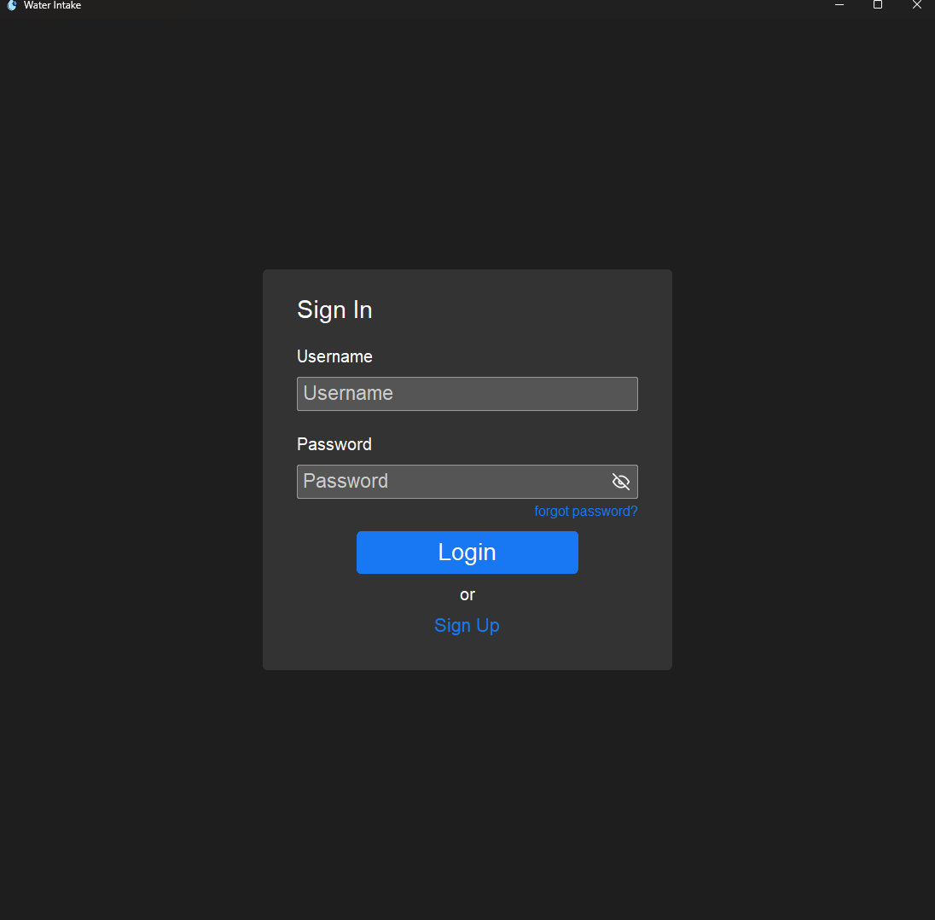
Login pAGE

Slide 10
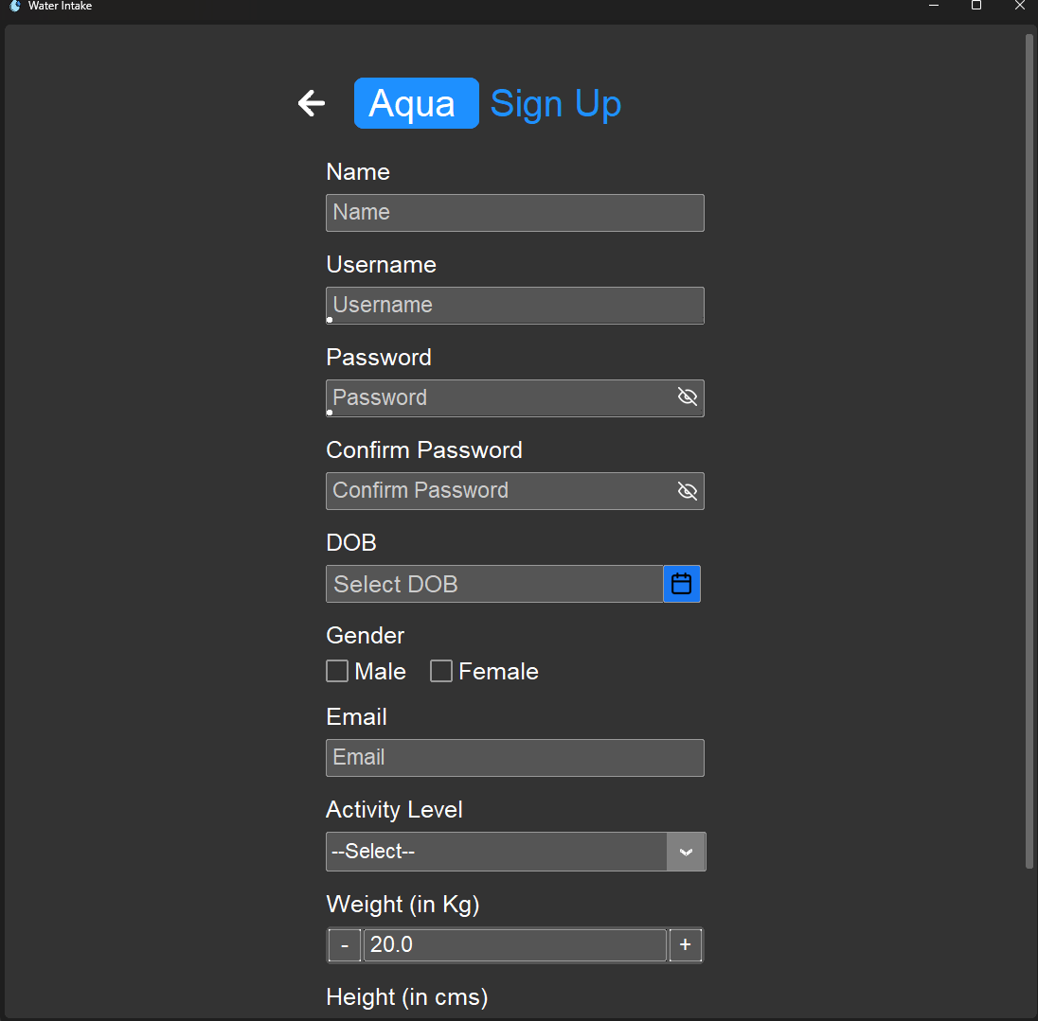
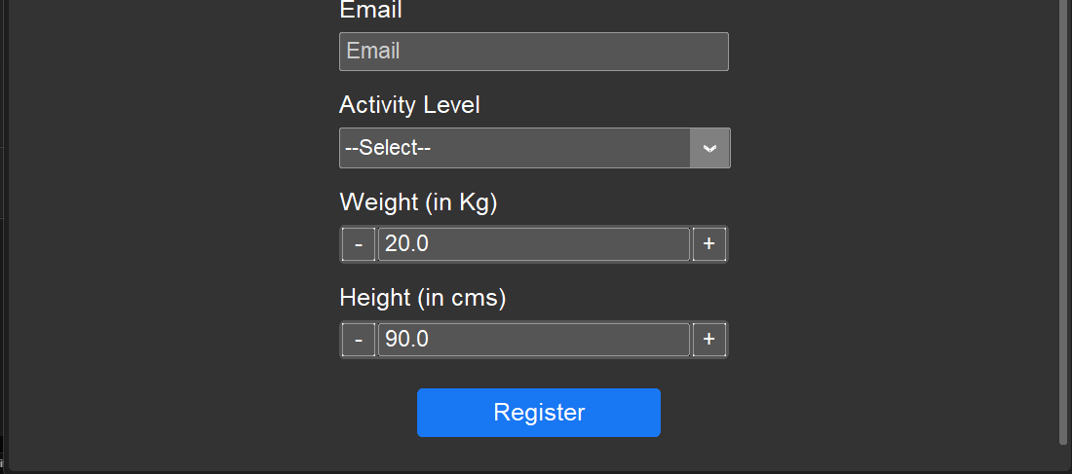
Register pAGE

Slide 11
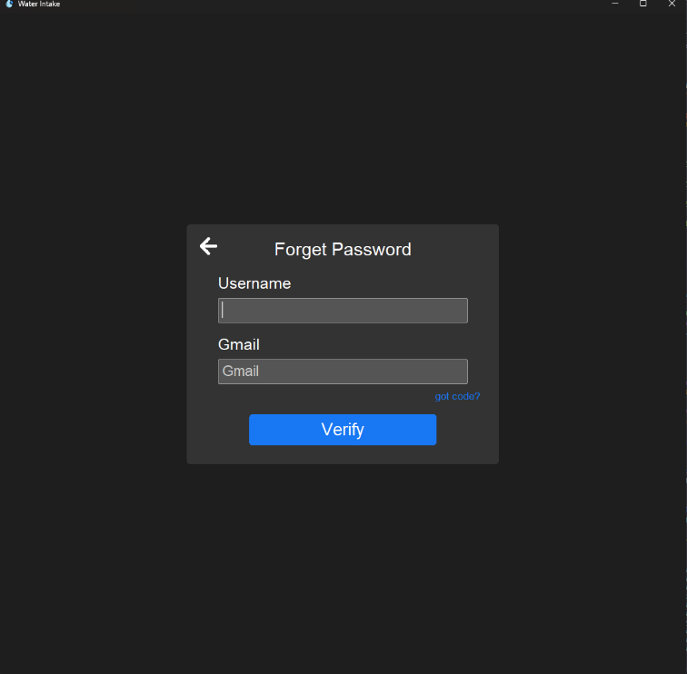
Forget pAGE

Slide 12
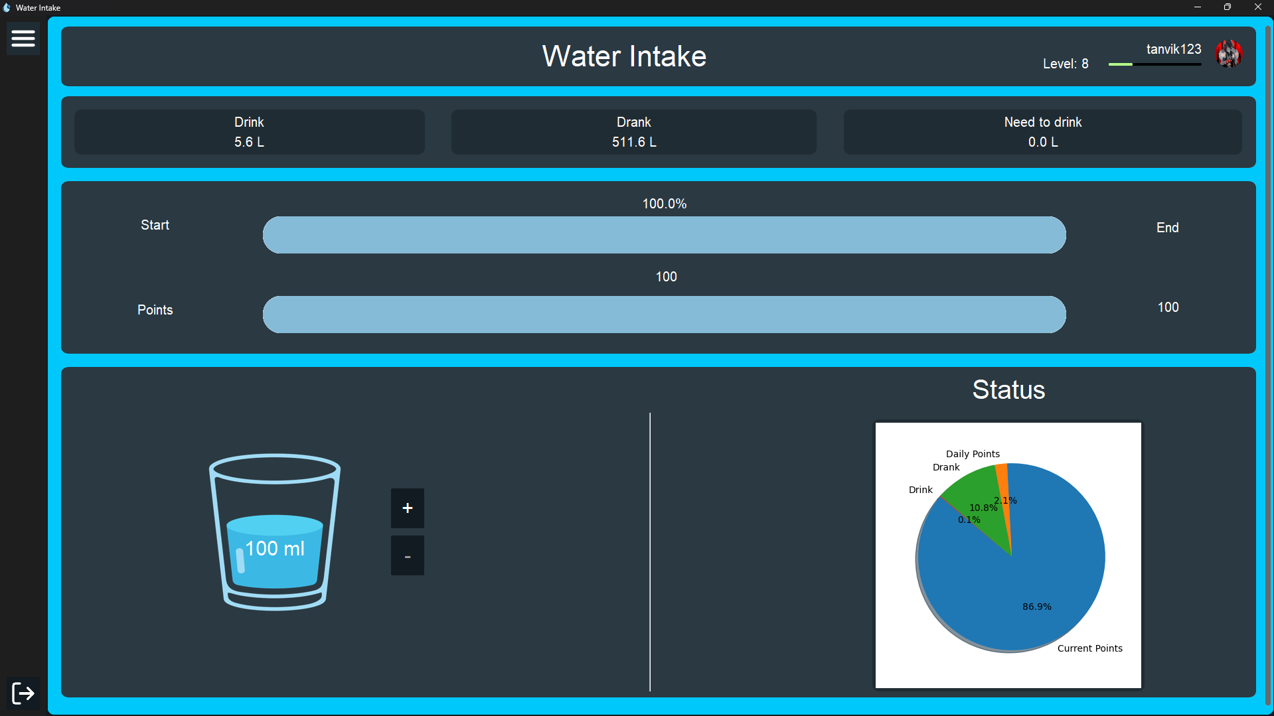
Home pAGE

Slide 13
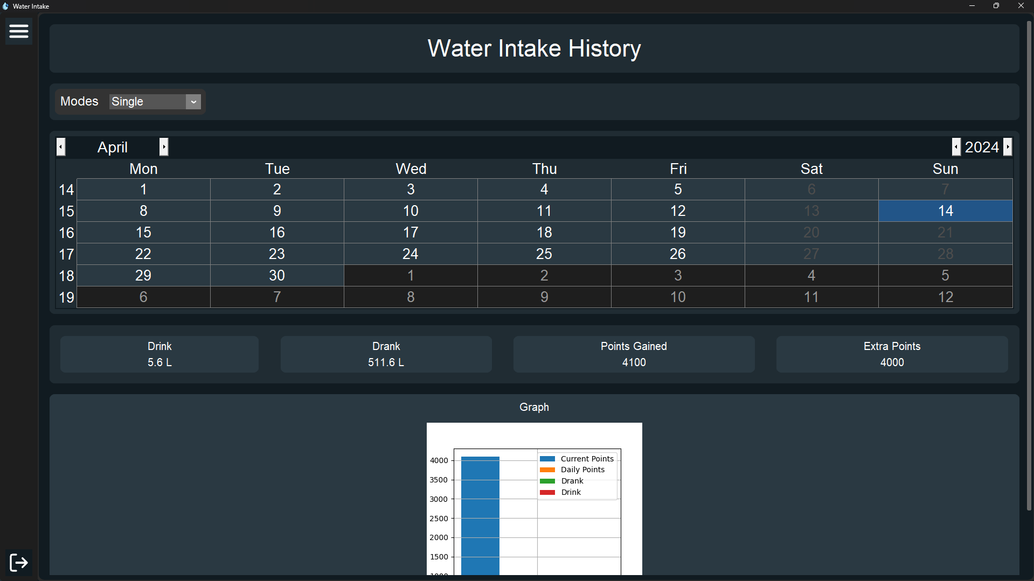
History pAGE

Slide 14
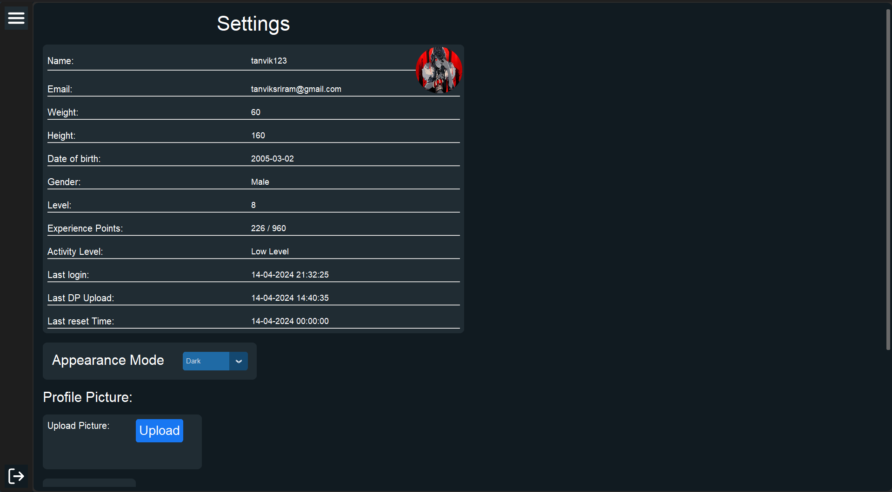
Settings pAGE

Slide 15
CONCLUSION
Tracks hydration, enhances habits
Personalized, error-proof, Easy hydration
Promotes healthier lifestyles effectively

Slide 16



